Slide 1
Chapter 3
Arithmetic for Computers
Notes:
Morgan Kaufmann Publishers
Chapter 3 — Arithmetic for Computers

Slide 2
Arithmetic for Computers
§3.1 Introduction
Operations on integers
  Addition and subtraction
  Multiplication and division
  Dealing with overflow
Floating-point real numbers
  Representation and operations
Chapter 3 — Arithmetic for Computers — <number>
Notes:
Morgan Kaufmann Publishers
Chapter 3 — Arithmetic for Computers

Slide 3

Integer Addition
Example: 7 + 6
§3.2 Addition and Subtraction
Overflow if result out of range
  Adding +ve and –ve operands, no overflow
  Adding two +ve operands
    Overflow if result sign is 1
  Adding two –ve operands
    Overflow if result sign is 0
Chapter 3 — Arithmetic for Computers — <number>
Notes:
Morgan Kaufmann Publishers
Chapter 3 — Arithmetic for Computers

Slide 4
Integer Subtraction
Add negation of second operand
Example: 7 – 6 = 7 + (–6)
  +7: 0000 0000 … 0000 0111
  –6: 1111 1111 … 1111 1010
  +1: 0000 0000 … 0000 0001
Overflow if result out of range
  Subtracting two +ve or two –ve operands, no overflow
  Subtracting +ve from –ve operand
    Overflow if result sign is 0
  Subtracting –ve from +ve operand
    Overflow if result sign is 1
Chapter 3 — Arithmetic for Computers — <number>
Notes:
Morgan Kaufmann Publishers
Chapter 3 — Arithmetic for Computers

Slide 5
Review: CMOS technology, gates and Boolean algebra
Complex Cell
CMOS Logic Gate
Transistor
Wires

Slide 6
Basic Technology: CMOS
CMOS: Complementary Metal Oxide Semiconductor
  NMOS (N-Type Metal Oxide
  Semiconductor) transistors
  PMOS (P-Type Metal Oxide
  Semiconductor) transistors
NMOS Transistor
  Apply a HIGH (Vdd) to its gate
  turns the transistor into a “conductor”
  Apply a LOW (GND) to its gate
  shuts off the conduction path
PMOS Transistor
  Apply a HIGH (Vdd) to its gate
  shuts off the conduction path
  Apply a LOW (GND) to its gate
  turns the transistor into a “conductor”
Vdd = 1V
GND = 0v
Vdd = 1V
GND = 0v
Notes:
Most of the memory and microprocessor chips in the market today are based on a relatively simple technology called CMOS.
CMOS stands for Complementary Metal Oxide Semiconductor.
The key word to remember is “Complementary” because it implies this technology consists of two types of transistors: N-type (NMOS) and P-type (PMOS).
PMOS is ideal to pass a high voltage (“1)” while NMOS is ideal to pass a low voltage(“0”); and these are all we need to build a binary digital computer.
The NMOS transistor pretty much follow our common sense: apply a high voltage to its gate, the transistor turns into a conductor and allows current to flow in either direction.
Apply a low voltage to its gate, the transistor is turned off and shuts off the conduction path between the two terminals.
The PMOS transistor acts exactly opposite-that’s whey they called it complementary :-)
Apply a high voltage to its gate, the transistor is turned off and you have a good insulator between the two terminals.
Apply a low voltage to its gate, the transistor is turned on and you have a conductor that allows current to flow in either direction.
PMOS transistors are good at conduction at high voltage level while NMOS transistors are good at conduction at low voltage level. The complementary structure enables fast transition at both high and low logic states.

Slide 7
Basic Components: CMOS Inverter
Vdd
Symbol
Circuit
PMOS
In
Out
In
Out
NMOS
Inverter Operation
Vdd
Vout
Vdd
Vdd
Vdd
Charge
Open
Out
Open
Discharge
Vdd
Vin
Notes:
The simplest component you can build using these transistors is an inverter that consists of two transistors: A PMOS and a NMOS transistor.
The gates of these two transistors are connected together to form the inverter input.
One side of these two transistors are connected together to form the inverter output.
The other side of the PMOS transistor is connected to the power supply: an almost infinite supply of electrons.
The other side of the NMOS transistor is connected to the GND: an bottomless sink for electrons.
Recall that when you apply a low voltage to the NMOS transistor, the transistor is shut off.
At the same time, apply a low voltage to the PMOS transistor turns it into a conductor.
Consequently, if you image you have a bucket at the output of the inverter to collect the electrons, your bucket will get fill up and you have a HIGH output (points to the curve).
As you slowly increase the input voltage, you will slowly turn off the PMOS transistors because as you may recall, the PMOS transistors has a “funny” habit of turning itself into an insulator as its gate voltage approaches HIGH.
At the same time, a high input voltage will turn on the NMOS transistor.
This is like pulling the plug in your kitchen sink and all the electrons you collect in your charge bucket will be drained and you have a LOW output.

Slide 8
Basic Components: CMOS Logic Gates
NAND Gate
NOR Gate
A
B
Out
A
B
Out
A
Out
0
0
1
A
Out
0
0
1
B
0
1
1
0
1
0
1
0
1
B
1
0
0
1
1
0
1
1
0
Vdd
Vdd
A
Out
B
B
Out
A
Notes:
The inverter alone cannot perform any “magic” for you. What you need are logic gates.
The first logic gate I want to introduce to you is the NAND gate.
You build a NAND gate by connecting two NMOS transistors in series and two PMOS transistors in parallel.
The two NMOS transistors in series require BOTH inputs to be the HIGH state in order to form a path from the gate’s output to GND and pull the output to low.
On the other hand, the two PMOS transistors in parallel require only 1 inputs to be in the LOW state to form a path from the power supply to the gate’s output to drive the output to H.
The NOR gate is the “dual” of the NAND gate. It has two NMOS transistors in parallel and two PMOS transistors in series.
The two NMOS transistors in parallel enable the output to be pulled low if ONLY one of the input is in the High state.
On the other hand, the two PMOS transistors in series require BOTH inputs to be in the Low state in order to pull the output to HIGH.
With all transistors sizes being equal, a NAND gate can pass a high signal faster than a NOR gate; similarly, a NOR gate can pass a low signal faster than a NAND gate. This is because a parallel conduction path is usually faster than a serial path.

Slide 9
Review: The Multiplexor
Selects one of the inputs to be the output, based on a control input
Lets build our ALU using a MUX:
S
0
1
note: we call this a 2-input mux
even though it has 3 inputs!
A
C
B

Slide 10
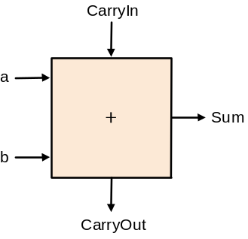
Different Implementations
  Don't want too many inputs to a single gate
  Dont want to have to go through too many gates
  for our purposes, ease of comprehension is important
Let's look at a 1-bit ALU for addition:
How could we build a 1-bit ALU for add, and, and or?
How could we build a 32-bit ALU?
c_{out} = a b + a c_{in} + b c_{in}
sum = a xor b xor c_{in}

Slide 11
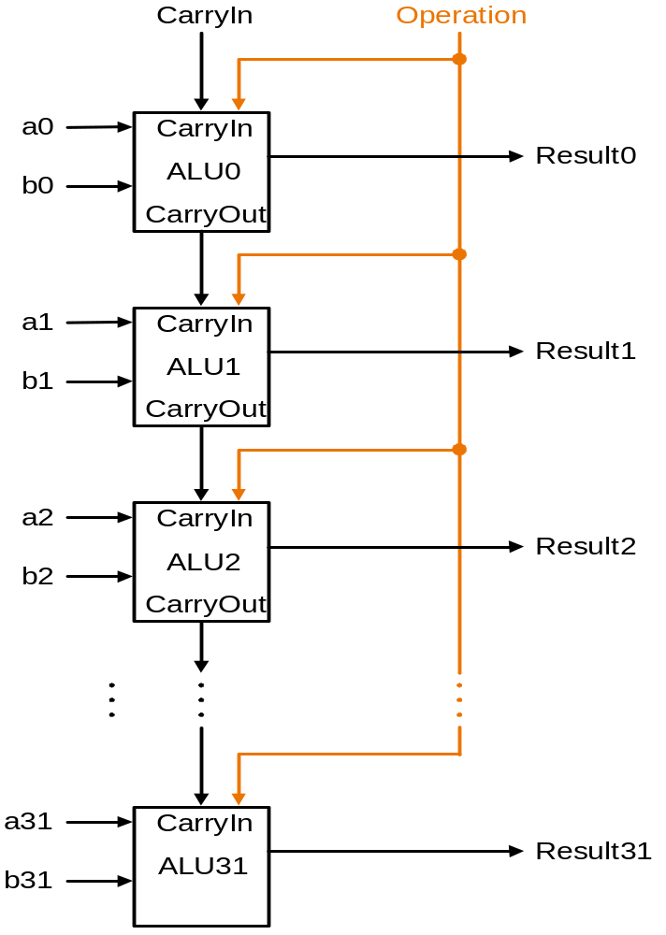
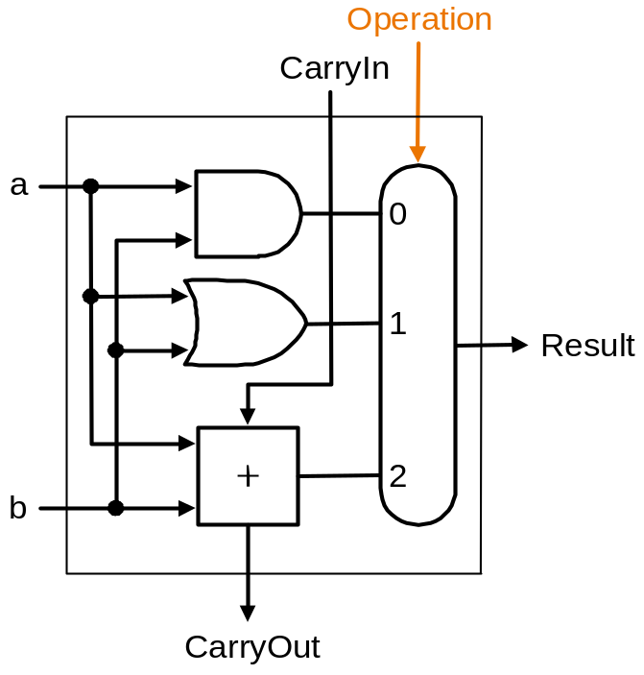
Building a 32 bit ALU

Slide 12
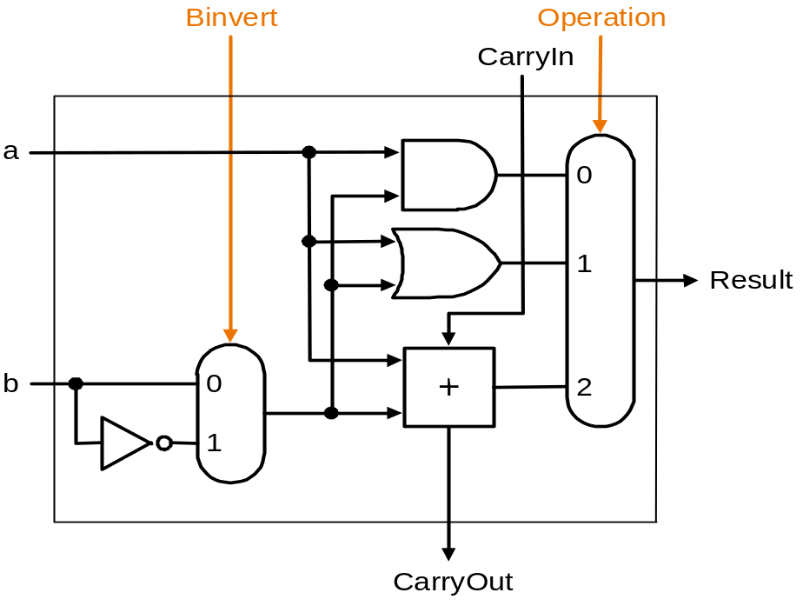
What about subtraction (a –b)?
Two's complement approach: just negate b and add.
How do we negate?
A very clever solution:

Slide 13
Problem: ripple carry adder is slow
Is a 32-bit ALU as fast as a 1-bit ALU?
Is there more than one way to do addition?
  two extremes: ripple carry and sum-of-products
  Can you see the ripple? How could you get rid of it?
c₁ = b₀c₀ + a₀c₀ + a₀b₀
c₂ = b₁c₁ + a₁c₁ + a₁b₁ c₂ =
c₃ = b₂c₂ + a₂c₂ + a₂b₂ c₃ =
c₄ = b₃c₃ + a₃c₃ + a₃b₃ c₄ =

Slide 14
Carry-lookahead adder
An approach in-between our two extremes
Motivation:
  If we didn't know the value of carry-in, what could we do?
  When would we always generate a carry? g_{i} = a_{i} b_{i}
  When would we propagate the carry? p_{i} = a_{i} + b_{i}
c₁ = g₀ + p₀c₀
c₂ = g₁ + p₁c₁ = g₁ + p₁g₀ + p₁p₀c₀
c₃ = g₂ + p₂c₂ = g₂ + p₂g₁ + p₂p₁g₀ + p₂p₁p₀c₀
c₄ = g₃ + p₃c₃ =
Feasible, but only for 4-bit adders

Slide 15
4-bit carry-lookahead adder
Cin
A B C-out
0 0 0 “kill”
0 1 C-in “propagate”
1 0 C-in “propagate”
1 1 1 “generate”
A0
S
B0
G
P
C1 =G0 + C0 • P0
A1
S
B1
G
P
C2 = G1 + G0 • P1 + C0 • P0 • P1
A2
S
B2
G
P
C3 = G2 + G1 • P2 + G0 • P1 • P2 + C0 • P0 • P1 • P2
A3
S
G
G
B3
P
P
C4 = . . .
Notes:
Names: suppose G0 is 1 => carry no matter what else => generates a carry
suppose G0 =0 and P0=1 => carry IFF C0 is a 1 => propagates a carry
Like dominoes
What about more than 4 bits?

Slide 16
Building bigger ALUs (16 bits)
Can’t build 16-bit adder that way – too big
Could use ripple carry of 4-bit CLA adders
Better: build carry-lookahead at a higher level
Need propagate and generate signals at this higher level
Here are these signals for four 4-bit adder blocks
“Super” propagate signals:
PO=p3*p2*p1*p0
P1=p7*p6*p5*p4
P2=p11*p10*p9*p8
P3=p15*p14*p13*p12
True only if each of the bits in the group will propagate a carry

Slide 17
Building bigger ALUs (continued)
“Super” generate signals:
If generate is true for the most significant bit in the group
or
Earlier generate is true and all intermediate propagates are true
G0=g3+p3*g2+p3*p2*g1+p3*p2*p1*g0
G1=g7+p7*g6+p7*p6*g5+p7*p6*p5*g4
etc…

Slide 18
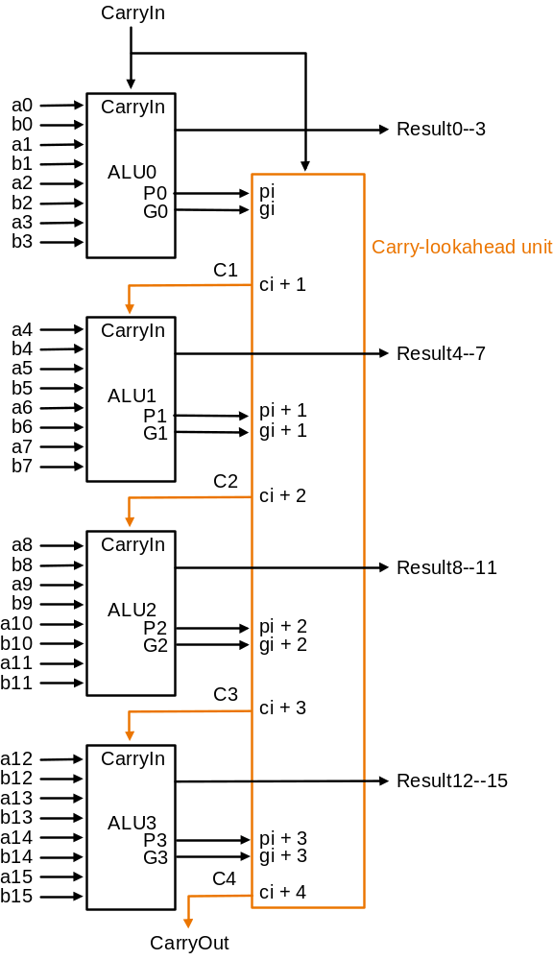
Use principle to build bigger adders

Slide 19

Multiplication
§3.3 Multiplication
Start with long-multiplication approach
multiplicand
1000
× 1001
1000
0000
0000
1000
1001000
multiplier
product
Length of product is the sum of operand lengths
Chapter 3 — Arithmetic for Computers — <number>
Notes:
Morgan Kaufmann Publishers
Chapter 3 — Arithmetic for Computers

Slide 20

Multiplication Hardware
Initially 0
Chapter 3 — Arithmetic for Computers — <number>
Notes:
Morgan Kaufmann Publishers
Chapter 3 — Arithmetic for Computers

Slide 21

Optimized Multiplier
Perform steps in parallel: add/shift
One cycle per partial-product addition
  That’s ok, if frequency of multiplications is low
Chapter 3 — Arithmetic for Computers — <number>
Notes:
Morgan Kaufmann Publishers
Chapter 3 — Arithmetic for Computers

Slide 22
LEGv8 Multiplication
Three multiply instructions:
  MUL: multiply
    Gives the lower 64 bits of the product
  SMULH: signed multiply high
    Gives the upper 64 bits of the product, assuming the operands are signed
  UMULH: unsigned multiply high
    Gives the higher 64 bits of the product, assuming the operands are unsigned
Chapter 3 — Arithmetic for Computers — <number>
Notes:
Morgan Kaufmann Publishers
Chapter 3 — Arithmetic for Computers

Slide 23
Division
§3.4 Division
Check for 0 divisor
Long division approach
  If divisor ≤ dividend bits
    1 bit in quotient, subtract
  Otherwise
    0 bit in quotient, bring down next dividend bit
Restoring division
  Do the subtract, and if remainder goes < 0, add divisor back
Signed division
  Divide using absolute values
  Adjust sign of quotient and remainder as required
quotient
dividend
1001
1000 1001010
-1000
10
101
1010
-1000
10
divisor
remainder
n-bit operands yield n-bit
quotient and remainder
Chapter 3 — Arithmetic for Computers — <number>
Notes:
Morgan Kaufmann Publishers
Chapter 3 — Arithmetic for Computers

Slide 24


Division Hardware
Initially divisor in left half
Initially dividend
Chapter 3 — Arithmetic for Computers — <number>
Notes:
Morgan Kaufmann Publishers
Chapter 3 — Arithmetic for Computers

Slide 25

Optimized Divider
One cycle per partial-remainder subtraction
Looks a lot like a multiplier!
  Same hardware can be used for both
Chapter 3 — Arithmetic for Computers — <number>
Notes:
Morgan Kaufmann Publishers
Chapter 3 — Arithmetic for Computers

Slide 26
LEGv8 Division
Two instructions:
  SDIV (signed)
  UDIV (unsigned)
Both instructions ignore overflow and division-by-zero
Chapter 3 — Arithmetic for Computers — <number>
Notes:
Morgan Kaufmann Publishers
Chapter 3 — Arithmetic for Computers

Slide 27
Floating Point
§3.5 Floating Point
Representation for non-integral numbers
  Including very small and very large numbers
Like scientific notation
  –2.34 × 10⁵⁶
  +0.002 × 10^{–4}
  +987.02 × 10⁹
In binary
  ±1.xxxxxxx₂ × 2^{yyyy}
Types float and double in C
normalized
not normalized
Chapter 3 — Arithmetic for Computers — <number>
Notes:
Morgan Kaufmann Publishers
Chapter 3 — Arithmetic for Computers

Slide 28
Floating Point Standard
Defined by IEEE Std 754-1985
Developed in response to divergence of representations
  Portability issues for scientific code
Now almost universally adopted
Two representations
  Single precision (32-bit)
  Double precision (64-bit)
Chapter 3 — Arithmetic for Computers — <number>
Notes:
Morgan Kaufmann Publishers
Chapter 3 — Arithmetic for Computers

Slide 29
IEEE Floating-Point Format
single: 8 bits
double: 11 bits
single: 23 bits
double: 52 bits
S
Exponent
Fraction
S: sign bit (0 ⇒ non-negative, 1 ⇒ negative)
Normalize significand: 1.0 ≤ |significand| < 2.0
  Always has a leading pre-binary-point 1 bit, so no need to represent it explicitly (hidden bit)
  Significand is Fraction with the “1.” restored
Exponent: excess representation: actual exponent + Bias
  Ensures exponent is unsigned
  Single: Bias = 127; Double: Bias = 1023
Chapter 3 — Arithmetic for Computers — <number>
Notes:
Morgan Kaufmann Publishers
Chapter 3 — Arithmetic for Computers

Slide 30
Single-Precision Range
Exponents 00000000 and 11111111 reserved
Smallest value
  Exponent: 00000001
  ⇒ actual exponent = 1 – 127 = –126
  Fraction: 000…00 ⇒ significand = 1.0
  ±1.0 × 2^{–126} ≈ ±1.2 × 10^{–38}
Largest value
  exponent: 11111110
  ⇒ actual exponent = 254 – 127 = +127
  Fraction: 111…11 ⇒ significand ≈ 2.0
  ±2.0 × 2⁺¹²⁷ ≈ ±3.4 × 10⁺³⁸
Chapter 3 — Arithmetic for Computers — <number>
Notes:
Morgan Kaufmann Publishers
Chapter 3 — Arithmetic for Computers

Slide 31
Double-Precision Range
Exponents 0000…00 and 1111…11 reserved
Smallest value
  Exponent: 00000000001
  ⇒ actual exponent = 1 – 1023 = –1022
  Fraction: 000…00 ⇒ significand = 1.0
  ±1.0 × 2^{–1022} ≈ ±2.2 × 10^{–308}
Largest value
  Exponent: 11111111110
  ⇒ actual exponent = 2046 – 1023 = +1023
  Fraction: 111…11 ⇒ significand ≈ 2.0
  ±2.0 × 2⁺¹⁰²³ ≈ ±1.8 × 10⁺³⁰⁸
Chapter 3 — Arithmetic for Computers — <number>
Notes:
Morgan Kaufmann Publishers
Chapter 3 — Arithmetic for Computers

Slide 32
Floating-Point Example
Represent –0.75
  –0.75 = (–1)¹ × 1.1₂ × 2^{–1}
  S = 1
  Fraction = 1000…00₂
  Exponent = –1 + Bias
    Single: –1 + 127 = 126 = 01111110₂
    Double: –1 + 1023 = 1022 = 01111111110₂
Single: 1011111101000…00
Double: 1011111111101000…00
Chapter 3 — Arithmetic for Computers — <number>
Notes:
Morgan Kaufmann Publishers
Chapter 3 — Arithmetic for Computers

Slide 33
Floating-Point Example
What number is represented by the single-precision float
11000000101000…00
  S = 1
  Fraction = 01000…00₂
  Fxponent = 10000001₂ = 129
x = (–1)¹ × (1 + 01₂) × 2^{(129 – 127)}
  = (–1) × 1.25 × 2²
  = –5.0
Chapter 3 — Arithmetic for Computers — <number>
Notes:
Morgan Kaufmann Publishers
Chapter 3 — Arithmetic for Computers

Slide 34
Floating-Point Addition
Consider a 4-digit decimal example
  9.999 × 10¹ + 1.610 × 10^{–1}
1. Align decimal points
  Shift number with smaller exponent
  9.999 × 10¹ + 0.016 × 10¹
2. Add significands
  9.999 × 10¹ + 0.016 × 10¹ = 10.015 × 10¹
3. Normalize result & check for over/underflow
  1.0015 × 10²
4. Round and renormalize if necessary
  1.002 × 10²
Chapter 3 — Arithmetic for Computers — <number>
Notes:
Morgan Kaufmann Publishers
Chapter 3 — Arithmetic for Computers

Slide 35
Floating-Point Addition
Now consider a 4-digit binary example
  1.000₂ × 2^{–1} + –1.110₂ × 2^{–2} (0.5 + –0.4375)
1. Align binary points
  Shift number with smaller exponent
  1.000₂ × 2^{–1} + –0.111₂ × 2^{–1}
2. Add significands
  1.000₂ × 2^{–1} + –0.111₂ × 2–1 = 0.001₂ × 2^{–1}
3. Normalize result & check for over/underflow
  1.000₂ × 2^{–4}, with no over/underflow
4. Round and renormalize if necessary
  1.000₂ × 2^{–4} (no change) = 0.0625
Chapter 3 — Arithmetic for Computers — <number>
Notes:
Morgan Kaufmann Publishers
Chapter 3 — Arithmetic for Computers

Slide 36
FP Adder Hardware
Much more complex than integer adder
Doing it in one clock cycle would take too long
  Much longer than integer operations
  Slower clock would penalize all instructions
FP adder usually takes several cycles
  Can be pipelined
Chapter 3 — Arithmetic for Computers — <number>
Notes:
Morgan Kaufmann Publishers
Chapter 3 — Arithmetic for Computers

Slide 37

FP Adder Hardware
Step 1
Step 2
Step 3
Step 4
Chapter 3 — Arithmetic for Computers — <number>
Notes:
Morgan Kaufmann Publishers
Chapter 3 — Arithmetic for Computers

Slide 38
Floating-Point Multiplication
Consider a 4-digit decimal example
  1.110 × 10¹⁰ × 9.200 × 10^{–5}
1. Add exponents
  For biased exponents, subtract bias from sum
  New exponent = 10 + –5 = 5
2. Multiply significands
  1.110 × 9.200 = 10.212 ⇒ 10.212 × 10⁵
3. Normalize result & check for over/underflow
  1.0212 × 10⁶
4. Round and renormalize if necessary
  1.021 × 10⁶
5. Determine sign of result from signs of operands
  +1.021 × 10⁶
Chapter 3 — Arithmetic for Computers — <number>
Notes:
Morgan Kaufmann Publishers
Chapter 3 — Arithmetic for Computers

Slide 39
Floating-Point Multiplication
Now consider a 4-digit binary example
  1.000₂ × 2^{–1} × –1.110₂ × 2^{–2} (0.5 × –0.4375)
1. Add exponents
  Unbiased: –1 + –2 = –3
  Biased: (–1 + 127) + (–2 + 127) = –3 + 254 – 127 = –3 + 127
2. Multiply significands
  1.000₂ × 1.110₂ = 1.1102 ⇒ 1.110₂ × 2^{–3}
3. Normalize result & check for over/underflow
  1.110₂ × 2^{–3} (no change) with no over/underflow
4. Round and renormalize if necessary
  1.110₂ × 2^{–3} (no change)
5. Determine sign: +ve × –ve ⇒ –ve
  –1.110₂ × 2^{–3} = –0.21875
Chapter 3 — Arithmetic for Computers — <number>
Notes:
Morgan Kaufmann Publishers
Chapter 3 — Arithmetic for Computers

Slide 40
FP Arithmetic Hardware
FP multiplier is of similar complexity to FP adder
  But uses a multiplier for significands instead of an adder
FP arithmetic hardware usually does
  Addition, subtraction, multiplication, division, reciprocal, square-root
  FP ↔ integer conversion
Operations usually takes several cycles
  Can be pipelined
Chapter 3 — Arithmetic for Computers — <number>
Notes:
Morgan Kaufmann Publishers
Chapter 3 — Arithmetic for Computers

Slide 41
FP Instructions in LEGv8
Separate FP registers
  32 single-precision: S0, …, S31
  32 double-precision: DS0, …, D31
  Sn stored in the lower 32 bits of Dn
FP instructions operate only on FP registers
  Programs generally don’t do integer ops on FP data, or vice versa
  More registers with minimal code-size impact
FP load and store instructions
  LDURS, LDURD
  STURS, STURD
Chapter 3 — Arithmetic for Computers — <number>
Notes:
Morgan Kaufmann Publishers
Chapter 3 — Arithmetic for Computers

Slide 42
FP Instructions in LEGv8
Single-precision arithmetic
  FADDS, FSUBS, FMULS, FDIVS
    e.g., FADDS S2, S4, S6
Double-precision arithmetic
  FADDD, FSUBD, FMULD, FDIVD
    e.g., FADDD D2, D4, D6
Single- and double-precision comparison
  FCMPS, FCMPD
  Sets or clears FP condition-code bits
Branch on FP condition code true or false
  B.cond
Chapter 3 — Arithmetic for Computers — <number>
Notes:
Morgan Kaufmann Publishers
Chapter 3 — Arithmetic for Computers

Slide 43
FP Example: °F to °C
C code:
float f2c (float fahr) {
return ((5.0/9.0)*(fahr - 32.0));
}
  fahr in S12, result in S0, literals in global memory space
Compiled LEGv8 code:
f2c:
LDURS S16, [X27,const5] // S16 = 5.0 (5.0 in memory)
LDURS S18, [X27,const9] // S18 = 9.0 (9.0 in memory)
FDIVS S16, S16, S18 // S16 = 5.0 / 9.0
LDURS S18, [X27,const32] // S18 = 32.0
FSUBS S18, S12, S18 // S18 = fahr – 32.0
FMULS S0, S16, S18 // S0 = (5/9)*(fahr – 32.0)
BR LR // return
Chapter 3 — Arithmetic for Computers — <number>
Notes:
Morgan Kaufmann Publishers
Chapter 3 — Arithmetic for Computers

Slide 44
Concluding Remarks
Bits have no inherent meaning
  Interpretation depends on the instructions applied
Computer representations of numbers
  Finite range and precision
  Need to account for this in programs
§3.9 Concluding Remarks
Chapter 3 — Arithmetic for Computers — <number>
Notes:
Morgan Kaufmann Publishers
Chapter 3 — Arithmetic for Computers

Slide 45
Concluding Remarks
ISAs support arithmetic
  Signed and unsigned integers
  Floating-point approximation to reals
Bounded range and precision
  Operations can overflow and underflow
Chapter 3 — Arithmetic for Computers — <number>
Notes:
Morgan Kaufmann Publishers
Chapter 3 — Arithmetic for Computers

